Slide 1
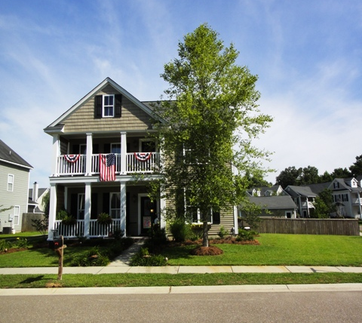
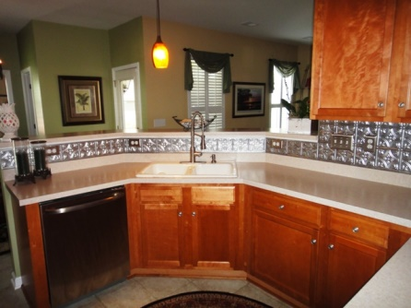
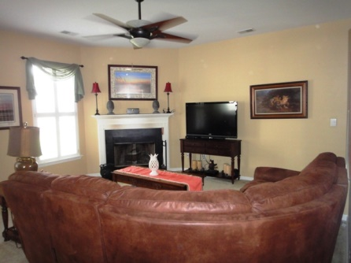
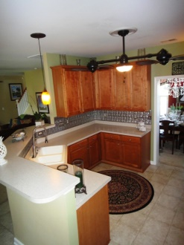
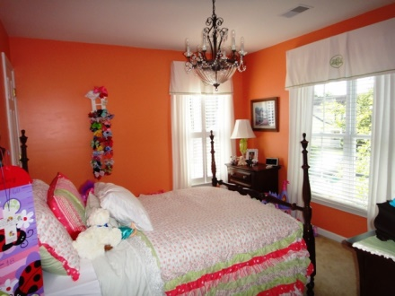
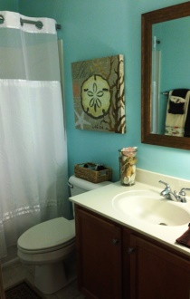
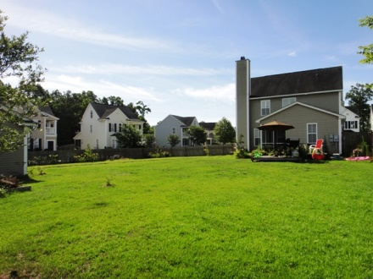
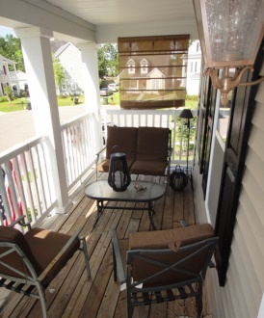
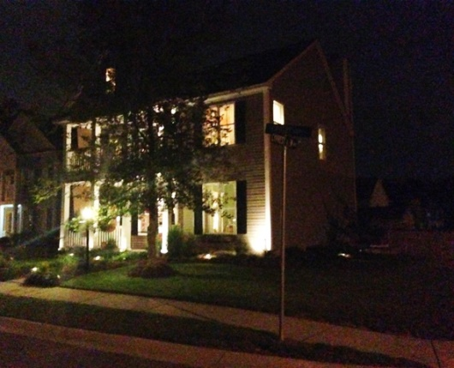
100 Crosby Ct Liberty Hall Plantation Goose Creek MLS# 1417420 $204,750 3 Bedrooms | 2½ Baths
This home is located in The OLD STYLE CHARLESTON COMMUNITY! This home comes with a Huge corner lot and a detached 2 car garage! You will love the double porches. A great relax in the mornings from the upstairs porch, front porch, or in your screened porch in your private backyard. This homes also features a fireplace with glass doors for the cooler seasons! This home comes with extensive upgrades!! upgraded porch light with dust to dawn sensors, from, Carolina Lantern Landscape lighting new updated landscape design drip irrigation Sunbrella sun shades on front porch NEW GE Profile stainless steal appliances/ new premium garbage disposal reproduction tin backsplash commercial grade faucet in kitchen under cabinet lighting custom crown molding and chair rail with formal door headers in Dining and Living room custom interior plantation shutters house sits on a double lot and was painted with Historic Charleston replica Colors. This home is Move in Ready. All we need is You!
Open House ~ Saturday, July 26 ~ 9am-1pm
Chris Kauffman
843-696-2113 M
chris.kauffman@cbunited.com

