Slide 1
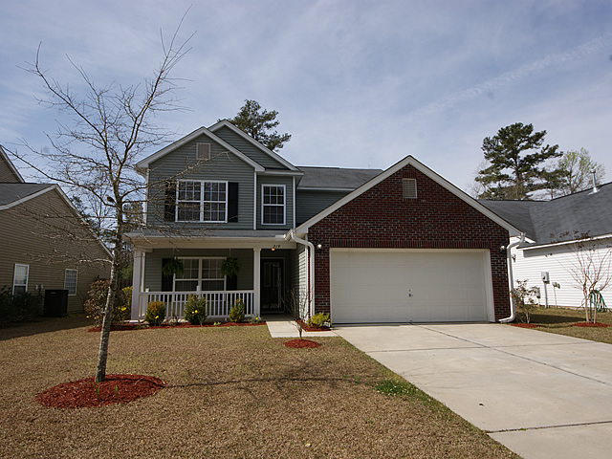
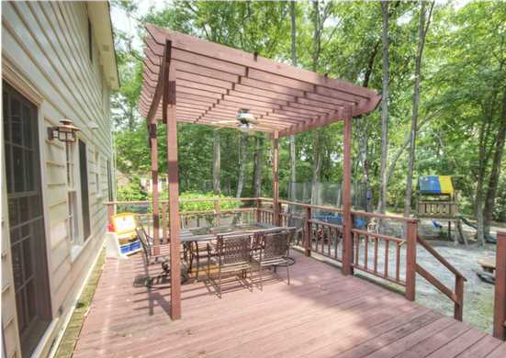
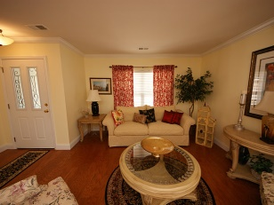
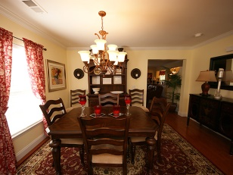
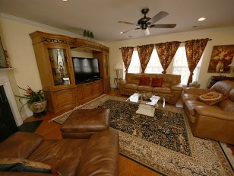
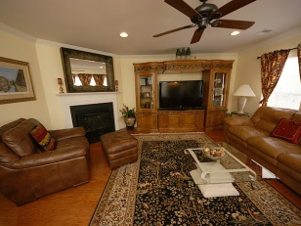
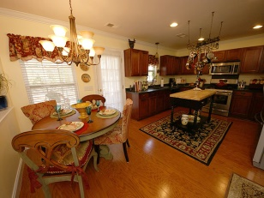
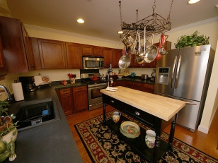
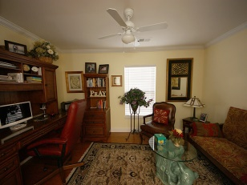
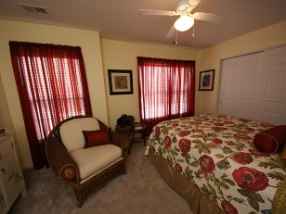
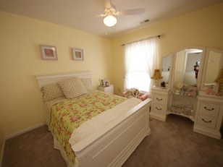
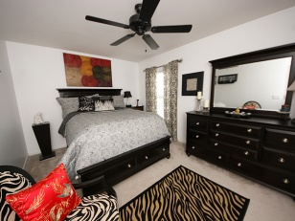
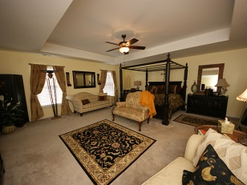
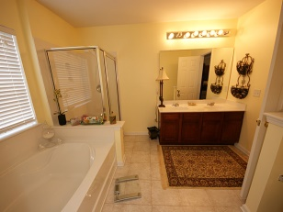
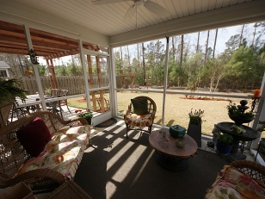
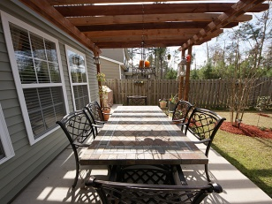
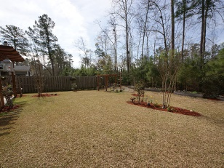
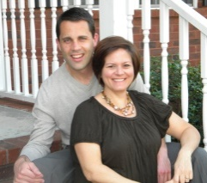
Minutes from Downtown Summerville
219 Breckingridge Dr
Summer Park
Ladson, SC 29456
MLS# 1420919
$239,000
This stunning home shows like a model home and is loaded with upgrades and in immaculate condition! Upon entering the home, you will find newly installed, gorgeous hardwood flooring throughout the downstairs, upgraded light fixtures, and crown molding throughout. Very spacious living room and dining room combo is perfect for entertaining. The gourmet kitchen has been upgraded to a gas stove, huge sink, 42" cabinets offer plenty of storage as well as the very large walk in pantry. Kitchen is open to the family room. The family room offers a fireplace and ample space. Downstairs is an office which has a full bath across the hall. Laundry room is large and provides access to the two car garage. Upstairs you'll find three more bedrooms with a full bath in between and one of the largest Master suites you'll ever see in this price range! The master bedroom has room for all your furniture plus a seating area! The master bath offers dual vanities, shower stall and tub plus HUGE walk in custom closet with his and her sides. The owner spared no expense with landscaping! Sit out on the screened in porch and admire all the private, wooded surroundings, or head out to the very large patio and sit under the custom built pergola. This home is a must see!
Larry & Kathy Mazalatis
Larry Cell 843-693-0529
Kathy Cell 843-693-0159
Office 843-871-9133
AGENTOWNED PREMIERE GROUP | 1800 TROLLEY RD | SUMMERVILLE, SC 29485

